Slide 1
PERSONAL AND COMMUNICATION SKILLS
Dr. Oleg Krikotov

Slide 2
CONTENT
1 Communication skills
2 The Concept of communication
3 Communication phenomena
4 Communicative style of the person
5 Methods for communication skills improving

Slide 3
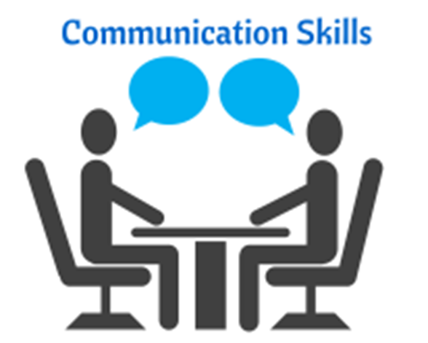
1 Communication skills

Slide 4
1 Communication skills
In today's world of technological advances, where any information can be easily obtained on the Internet, the ability to communicate is becoming an increasingly valuable skill. Developed communication skills help to successfully sell goods, negotiate, speak to the public, understand the person and be understood by him/her.

Slide 5
1 Communication skills
Communication skills are very important for personal development in general, as they determine the success of interaction with the world, surrounding people, yourself, as well as allow you to express yourself through creativity.
Difficulties in communication can arise when the communication skills of a particular person are not sufficiently developed. Life experience teaches us how to solve many problems through negotiations, but sometimes the circumstances are such that there is not enough knowledge to solve the problem.

Slide 6
1 Communication skills
We also surrender to the behavioural stereotypes we have developed during our lives, and when they do not produce the desired effect.

Slide 7
1 Communication skills
To be able to cope with confusion and take the situation under control helps to develop communication skills. Their development in the form of a game, when you train yourself in artificially creates conditions that make it difficult to communicate effectively and achieve the goals of negotiations, helps to expand communication experience.

Slide 8

2 The Concept of communication

Slide 9
2 The Concept of communication
The definition of the term "communication" begins with the characterization of multiple information systems for the transmission of human speech, signals and images. According to this, the term communication is literally "a measure of participation in the process of consumption, exchange and use of information". But this means not just to transmit and receive information. In the process of communication, a communicative community is formed. It is characterized by relations of unity, interrelation, interaction, mutual understanding, etc.

Slide 10
2 The Concept
of communication
The communication structure should distinguish the purpose from the motivation. The purpose is a clear, rational intention. A motive is a hidden intention. It is often hidden because it may not be of general significance.
The context of communication is the entire system of goals and results, coding and decoding of hidden motives and personal goals. For the communication process to be predictable, it is necessary to report on all its structural components.

Slide 11
2 The Concept
of communication
Types of communication: convincing, suggestive and emotionally energizing.
WP4 Leader: ISLA

Slide 12
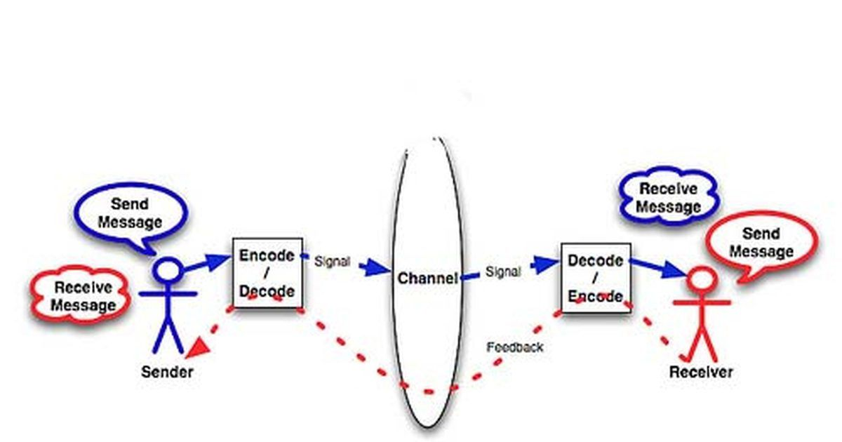
3 The communication
phenomena
WP5 Leader: UJ

Slide 13
3 The communication
phenomena
1. Phenomenon of "adequacy".
2. The phenomenon of "fulfilling expectations".
3. Phenomenon of "dominants".
4. Phenomenon of "vandalism".
5. Phenomenon of "memory intervals".
6. Phenomenon of "mnemonic".
7. The phenomenon of "personal reality".
8. Phenomenon of "burnout".
9. Phenomenon of "preserving traditions".
10. The phenomenon of "resistance to imposing".
11. The phenomenon of "dark forces".
WP3 Leader: UCY

Slide 14
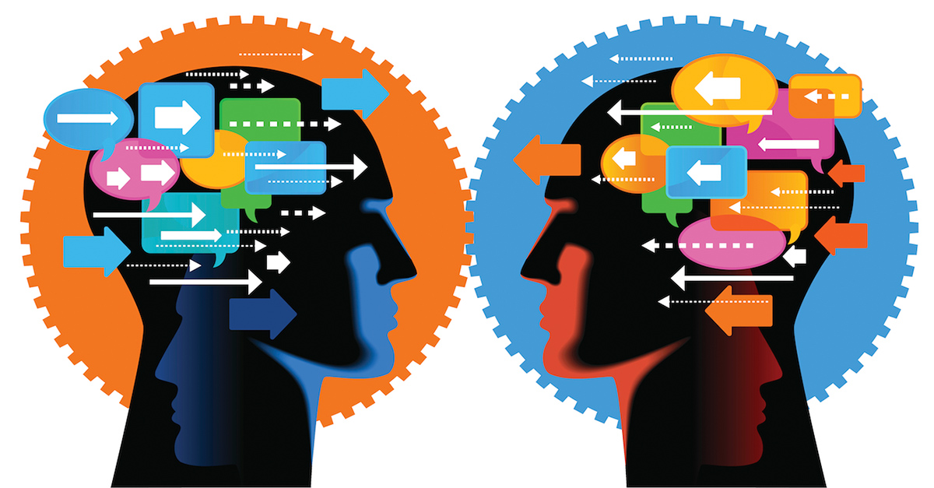
4 Communicative style
of the person

Slide 15
4 Communicative style of the person
A person's communicative style is a set of habitual ways and means of establishing and maintaining contacts with others in various forms of interaction: conversations, negotiations, discussions, disputes, as well as in various situations of communication - in the development of ideas, making and formulating decisions and overcoming conflicts.

Slide 16
4 Communicative style of the person
The synergistic style (from Greek synergeia - cooperation, commonwealth) differs in the fact that the personality of the interaction with partners (partner) contributes to the unification and increase the efficiency of joint activities. This is possible, firstly, due to the unimpeded information exchange between the participants of the relations and, secondly, due to the synchronization of their energies and coherence of their activities.

Slide 17
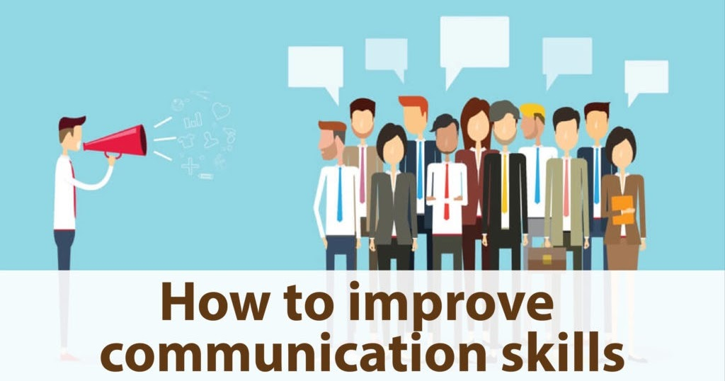
5 Methods for communication skills improving

Slide 18
5 Methods for communication skills improving
1. Listen carefully
2. Learn from others
3. Understanding non-verbal signals
4. Writing practice
5. Play word games
6. Read business magazines
7. Learn online

Slide 19
THANK
YOU
FOR
ATTENTION

